Slide 1

Activity
Chapter 4

Slide 2

What is an activity ?

Slide 3
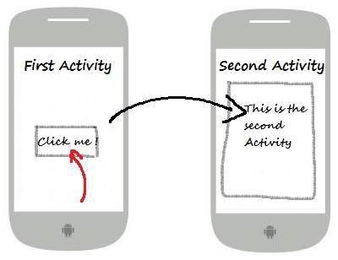
Introduction to Activities
The Activity class is a crucial component of an Android app, and the way activities are launched and put together is a fundamental part of the platform's application model.
Unlike programming paradigms in which apps are launched with a main() method, the Android system initiates code in an Activity instance by invoking specific callback methods that correspond to specific stages of its lifecycle.
https://developer.android.com/guide/components/activities/intro-activities

Slide 4
The concept of activities
The mobile-app experience differs from its desktop counterpart in that a user's interaction with the app doesn't always begin in the same place. Instead, the user journey often begins non-deterministically. For instance, if you open an email app from your home screen, you might see a list of emails. By contrast, if you are using a social media app that then launches your email app, you might go directly to the email app's screen for composing an email.
The Activity class is designed to facilitate this paradigm. When one app invokes another, the calling app invokes an activity in the other app, rather than the app as an atomic whole. In this way, the activity serves as the entry point for an app's interaction with the user. You implement an activity as a subclass of the Activity class.

Slide 5
The concept of activities (Cont..)
An activity provides the window in which the app draws its UI. This window typically fills the screen, but may be smaller than the screen and float on top of other windows. Generally, one activity implements one screen in an app. For instance, one of an app’s activities may implement a Preferences screen, while another activity implements a Select Photo screen.
Most apps contain multiple screens, which means they comprise multiple activities. Typically, one activity in an app is specified as the main activity, which is the first screen to appear when the user launches the app. Each activity can then start another activity in order to perform different actions. For example, the main activity in a simple e-mail app may provide the screen that shows an e-mail inbox. From there, the main activity might launch other activities that provide screens for tasks like writing e-mails and opening individual e-mails.

Slide 6
The concept of activities (Cont..)
Generally, in an application, there is more than one activity that is connected to each other with different tasks.
What should be noted is that each Activity must be registered in the AndroidManifest.xml. By default, it will be registered when you create a new Activity in an automatic way.
The trick is to right-click on the package name → New → Activity → select the available Activity template.

Slide 7
Activity Lifecycle
Activities have a life cycle in a stack in a virtual sandbox prepared by the Dalvik Virtual Machine (DVM) or Android Runtime (ART) which is last in first out.
The callback methods can be used to perform various processes related to the activity's state. For example, doing all component initialization in onCreate (), disconnecting from connection to server on onStop () or onDestroy () and so on.
A good understanding of the activity lifecycle will make the implementation of your application design better. This will also minimize the occurrence of unwanted errors / bugs / force closes.

Slide 8
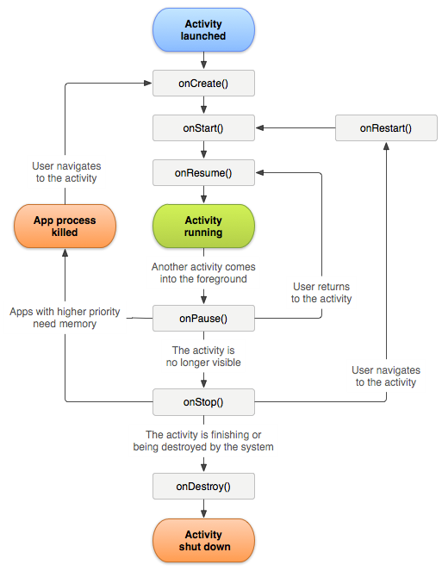
Activity Lifecycle
https://www.dicoding.com/academies/14/freemodule/113

Slide 9
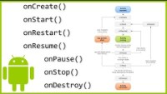
The Activity Lifecycle

Slide 10
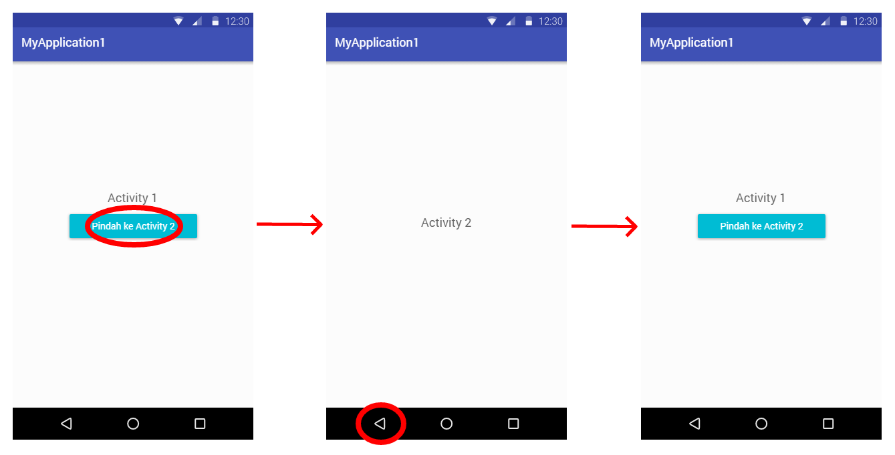
Last In, First Out (LIFO)
https://www.dicoding.com/academies/14/freemodule/113

Slide 11
Lifecycle callbacks
onCreate()
onStart()
onResume()
onPause()
onStop()
onDestroy()

Slide 12
Lifecycle callbacks - onCreate()
You must implement this callback, which fires when the system first creates the activity. On activity creation, the activity enters the Created state. In the onCreate() method, you perform basic application startup logic that should happen only once for the entire life of the activity. For example, your implementation of onCreate() might bind data to lists, associate the activity with a ViewModel, and instantiate some class-scope variables. This method receives the parameter savedInstanceState, which is a Bundle object containing the activity's previously saved state. If the activity has never existed before, the value of the Bundle object is null.
If you have a lifecycle-aware component that is hooked up to the lifecycle of your activity it will receive the ON_CREATE event. The method annotated with @OnLifecycleEvent will be called so your lifecycle-aware component can perform any setup code it needs for the created state.

Slide 13
Lifecycle callbacks - onStart()
When the activity enters the Started state, the system invokes this callback. The onStart() call makes the activity visible to the user, as the app prepares for the activity to enter the foreground and become interactive. For example, this method is where the app initializes the code that maintains the UI.
When the activity moves to the started state, any lifecycle-aware component tied to the activity's lifecycle will receive the ON_START event.
The onStart() method completes very quickly and, as with the Created state, the activity does not stay resident in the Started state. Once this callback finishes, the activity enters the Resumed state, and the system invokes the onResume() method.

Slide 14
Lifecycle callbacks - onResume()
When the activity enters the Resumed state, it comes to the foreground, and then the system invokes the onResume() callback. This is the state in which the app interacts with the user. The app stays in this state until something happens to take focus away from the app. Such an event might be, for instance, receiving a phone call, the user’s navigating to another activity, or the device screen’s turning off.
When the activity moves to the resumed state, any lifecycle-aware component tied to the activity's lifecycle will receive the ON_RESUME event.
If the activity returns to the Resumed state from the Paused state, the system once again calls onResume() method. For this reason, you should implement onResume() to initialize components that you release during onPause(), and perform any other initializations that must occur each time the activity enters the Resumed state.

Slide 15
Lifecycle callbacks - onPause()
The system calls this method as the first indication that the user is leaving your activity (though it does not always mean the activity is being destroyed); it indicates that the activity is no longer in the foreground (though it may still be visible if the user is in multi-window mode). Use the onPause() method to pause or adjust operations that should not continue (or should continue in moderation) while the Activity is in the Paused state, and that you expect to resume shortly. There are several reasons why an activity may enter this state. For example:

Slide 16
Lifecycle callbacks - onStop()
When your activity is no longer visible to the user, it has entered the Stopped state, and the system invokes the onStop() callback. This may occur, for example, when a newly launched activity covers the entire screen. The system may also call onStop() when the activity has finished running, and is about to be terminated.
When the activity moves to the stopped state, any lifecycle-aware component tied to the activity's lifecycle will receive the ON_STOP event. This is where the lifecycle components can stop any functionality that does not need to run while the component is not visible on the screen.

Slide 17
Lifecycle callbacks - onDestroy()
onDestroy() is called before the activity is destroyed. The system invokes this callback either because:
the activity is finishing (due to the user completely dismissing the activity or due to finish() being called on the activity), or
the system is temporarily destroying the activity due to a configuration change (such as device rotation or multi-window mode)

Slide 18
Intent
Intent is a class provided for moving from one page to another.
Intent function:
To call another activity that is still in one package
To call other activities that are not in a package and project
To call activities that are already in Android's internal functions such as Dial Number, Open Browser and others.

Slide 19
Intent Type
There are 2 Intents:
Implicit intent is an intent that calls existing activity functions in Android's internal functions such as Dial Number, Open Browser and others.
Explicit Intent which calls another Activity that is still in one project or another project.

Slide 20
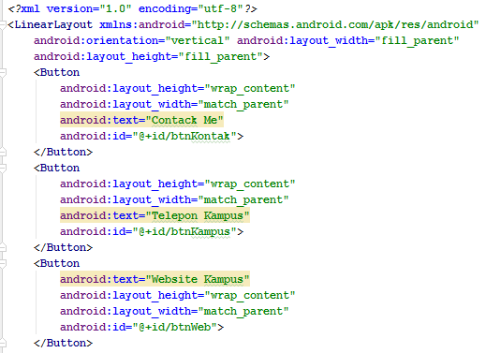
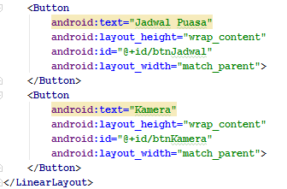
Practice Implicit intent - Activity_main.xml

Slide 21
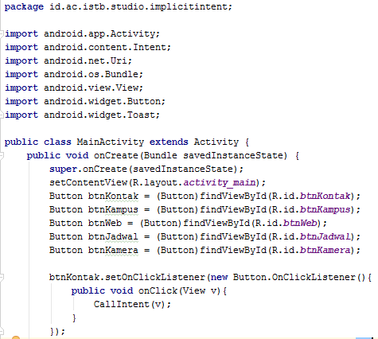
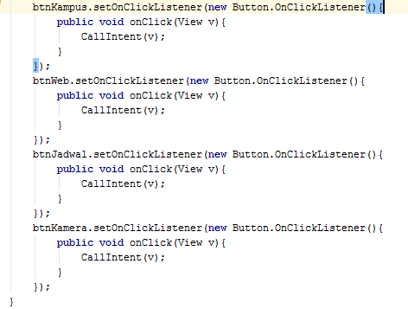
Practice Implicit intent - Main_activity.java

Slide 22
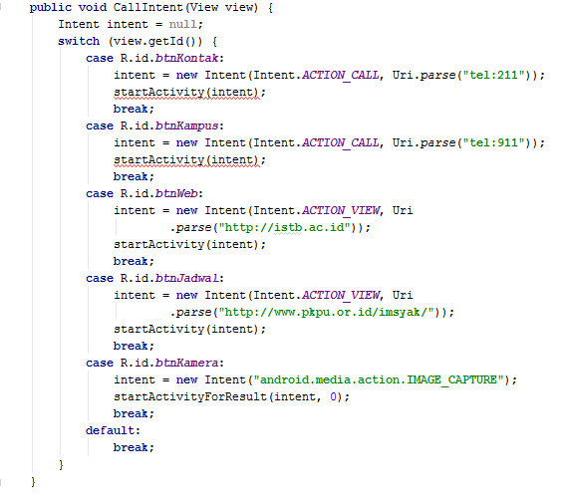
Practice Implicit intent - Main_activity.java (Cont..)

Slide 23
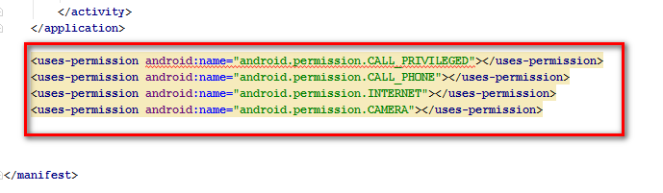
Practice Implicit intent - AndroidManifest
Modify the AndroidManifest file by adding the following code:

Slide 24
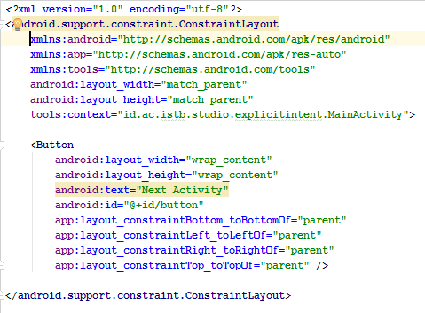
Practice Explicit intent - Activity_main.xml

Slide 25
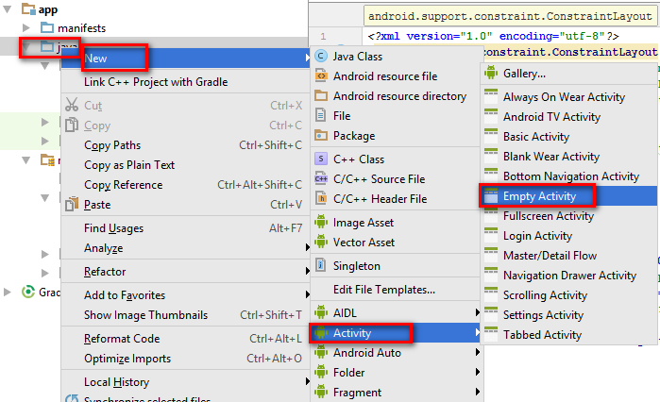
Then create a new Activity with the name: NextActivity

Slide 26
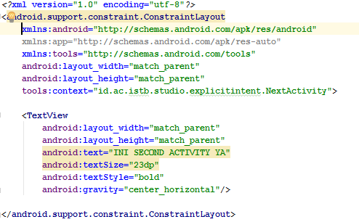
Practice Explicit intent - Activity_next.xml

Slide 27
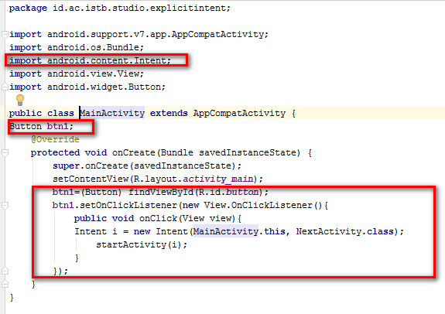
Practice Explicit intent - Main_activity.java

Slide 28
Toast
Toast is a class used to display messages / warnings on Android (similar to alert boxes, message boxes, etc.).
Toast structure: Toast.makeText (context, text, duration) .show ();
Information:
context: usually an Activity
text: the message content to be displayed.
duration: the duration the message was displayed.
There are 2 duration in toas:
LENGTH_LONG, this duration means it will display the message for a long period of time.
LENGTH_SHORT, this duration means it will display the message for a short period of time.

Slide 29
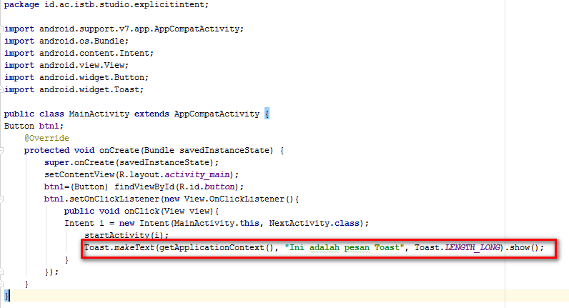
Practice Toast
Reopen the practice using Explicit intent. To practice Toast, all you have to do is add the following code to Main_activity.java

Slide 30
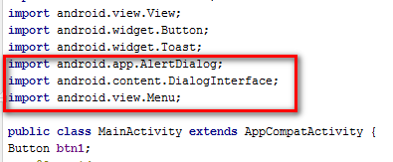
Alert Dialog
Alert Dialog serves to alert the user when they want to perform a certain action.
For example, in our practice it will be shown when the user presses the back button on our Android device, then an alert will appear in the form of an Alert Dialog.
Reopen the practice using Explicit intent. For the Alert Dialog practice, all you have to do is add the following code to Main_activity.java

Slide 31
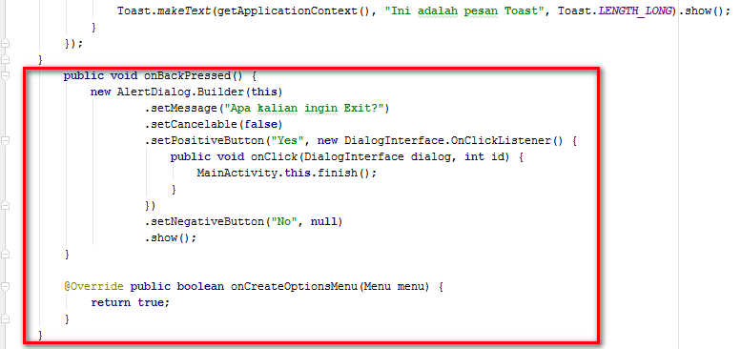

Slide 32
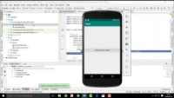
Intent and Toast

Slide 33
References
https://developer.android.com/guide/components/activities/activity-lifecycle
https://developer.android.com/guide/components/activities/intro-activities
https://www.dicoding.com/academies/14/freemodule/113

Slide 34

https://cdn.brilio.net/news/2016/08/01/88261/410535-12-meme-anak-programmer.png

Slide 35

Thank You
See you next week

